Slide 1
Minor Project -I :– B.Tech(CSE, V Sem)
Topic: AI Interview Chatbot
Guided by: Dr. K.B. Meena
Team Members
Yash Khandewal-231B401
Yash Singhal -231B405
Arpita Nayar-231B446

Slide 2
Problem Statement
Students often lack structured practice for interviews.
Existing tools are either generic or not interactive.
Difficulty levels and domains are not personalized.
There is a gap in providing real-time feedback and improvement tracking.

Slide 3
Introduction
Preparing for interviews can be stressful and unstructured.
Our idea: an AI-based chatbot that simulates interviews.
It will ask questions, adapt difficulty, and provide feedback.
Current stage: Research, analysis, and project planning.

Slide 4
Technology Exploration
Programming Language: Python
Libraries Studied: NLTK, Scikit-learn, Pandas, Kaggle API
Tools Considered: VS Code, Kaggle datasets
Concepts Reviewed: NLP basics, tokenization, scoring methods, SDLC models.
DATASET - “Data Science Interview Questions (FAANG & Top Companies)” (2018–2022)

Slide 5
DATASET
Source: Kaggle – “Data Science Interview Questions (F (2018–2022)”
Contains 111+ real interview questions .
Covers domains: ML, DL, Statistics, EDA.
Questions categorized by difficulty (Easy, Medium, Hard).
IMPLEMENTING OF DATA SET IN VARIOUS STEP
Dataset fetched via Kaggle API (CSV → JSON).
• Machine Learning
• Deep Learning
Tools: pandas (data handling), NLTK .

Slide 6
Value Addition
Provides a safe, stress-free environment for interview practice.
Adapts difficulty based on learner’s progress.
Offers instant feedback using NLP techniques.
Bridges gap between theory preparation and real interview scenarios.

Slide 7
What We Aim to Build
A chatbot that:
Conducts mock interviews in chosen field
Uses NLP to analyze answers
Provides constructive feedback to learners
Mock Interview in Chosen difficulty level.

Slide 8
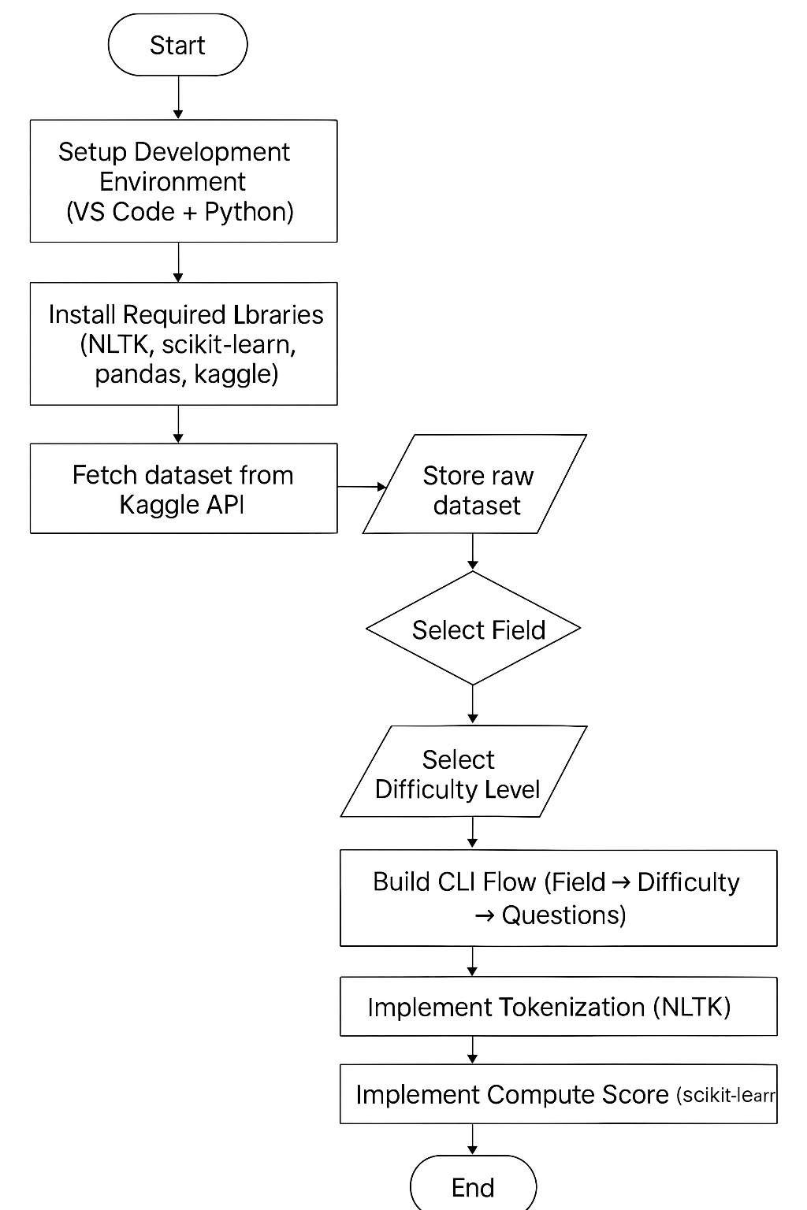
PROJECT WORKFLOW
1. Setup environment (VS Code + Python)
2. Collect dataset (Kaggle API)
3. Clean & preprocess data
4. Define interview flow (field → difficulty → question)
5. Apply NLP techniques (tokenization, scoring)
6. Integrate components into chatbot

Slide 9
Planned Workflow
1. Setup environment (VS Code + Python)
2. Collect dataset (Kaggle API)
3. Clean & preprocess data
4. Define interview flow (field → difficulty → question)
5. Apply NLP techniques (tokenization, scoring)
6. Integrate components into chatbot

Slide 10
Work Done So Far
- Reviewed research papers and existing solutions
- Identified key concepts, limitations, and approaches
- Studied NLP foundations and SDLC models
- Designed workflow & flowchart for chatbot development
- Explored dataset sources for interview Q&A

Slide 11
Future Work
- Start actual implementation & coding
- Enhance chatbot with voice-based interaction
- Expand dataset for multiple domains
- Deploy as web or mobile application

Slide 12
Reference Papers Studied
- Reviewed multiple research papers on NLP-based chatbots.
- Studied methodologies for question answering systems.
- Explored frameworks for AI-driven adaptive learning.
- Key insights helped in identifying limitations & possible approaches.

Slide 13
THANKYOU

